Slide 2
Table of Contents
How to Log In to Send Pro Enterprise
How to Ship a Package
How to See Shipping History, Track and Void a Shipment
How to Print Stamps
How to Send Certified Mail/Proof of Mailing
How to Re-Print Stamps
How to view stamp print history
How to Align the Printer correctly to print stamps
Rollins – Ordering Supplies
Internal Rollins Support

Slide 3
How to Log Using the Single Sign On Feature
Link to the Application - https://rollins.sendproenterprise.com/Composer/Runtime/Index/Desktop%20App
(This should work with Single Sign On) – If it asks you for a username and password, you may not be set up properly. Have your RAA submit a case through our portal to make sure your credentials are entered properly
NOTE: If you do not have access to the application postal advocate will need authorization from your RAA to be added.
Information needed to add a user is:
Full Name
Phone Number
Email
Employee Number
Branch Number

Slide 4
How to Ship a Package

Slide 5
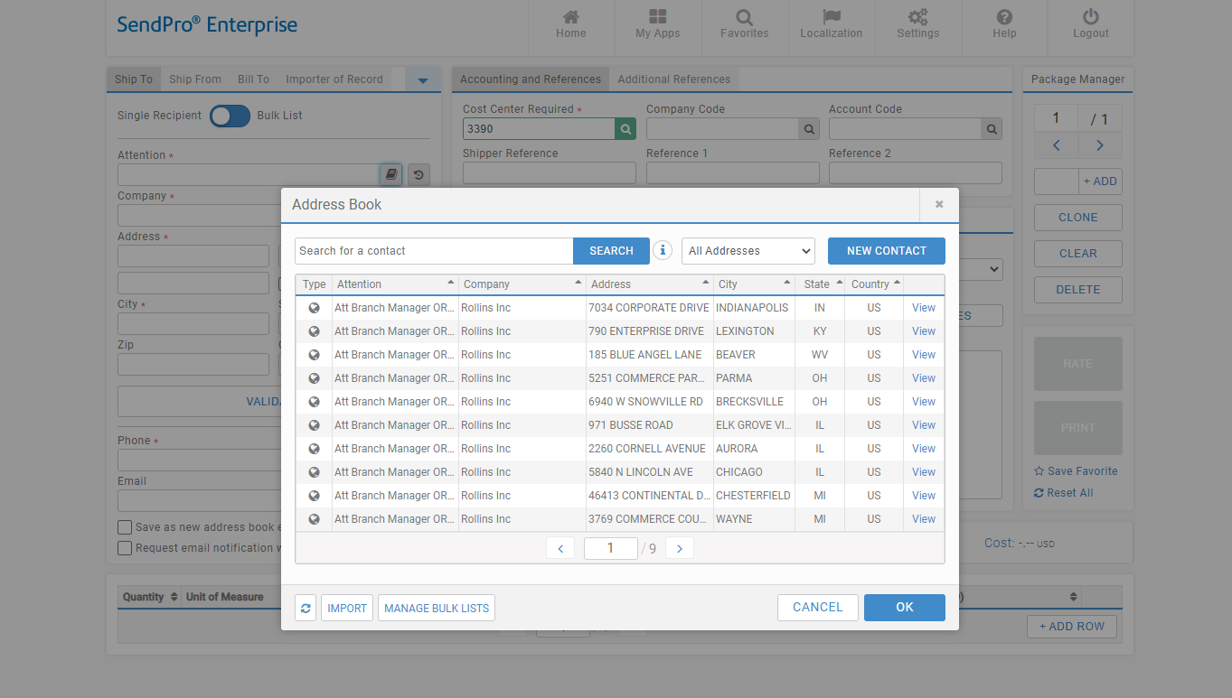
How to Ship a Package
To select an address that is saved in the address book.
To save a new address into the address book.
Enter emails to notify of package delivery.
Select an address and click ok.

Slide 6
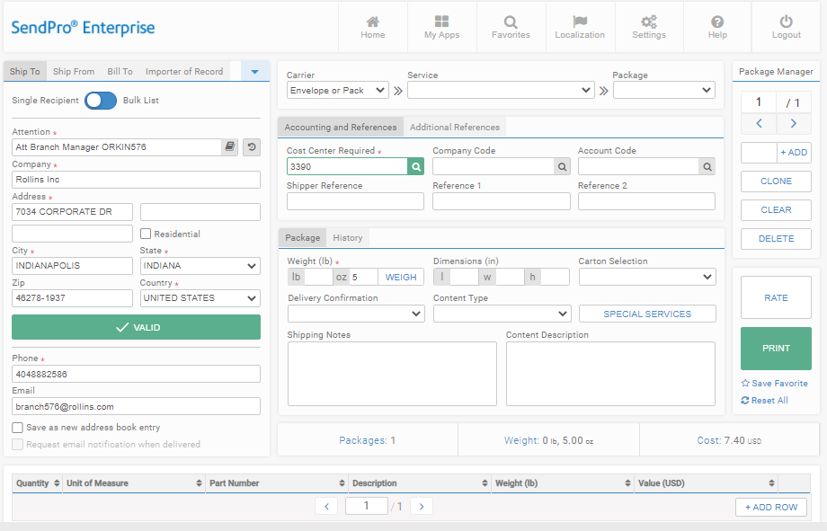
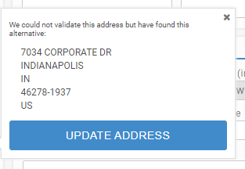
How to Ship a Package
Allows to manually select a carrier or service. Within this list is an alternate rate group titled "Your Brown Box." This rate group includes options for rate shopping large or heavy items which are not included in the default "Envelope or Pack" option.
Cost center is predefined by user. Cost Center = Branch Number
Enter Weight
Enter weight, dimension if needed and # of cartons if more than one.
Select if it’s a residential address
When entering the ship to address, make sure to click “validate”, this will allow the address to be validates by the postal office database to make sure it’s the correct address. If you do not validate and the address is incorrect you will get charged a correction fee by the carrier.

Slide 7
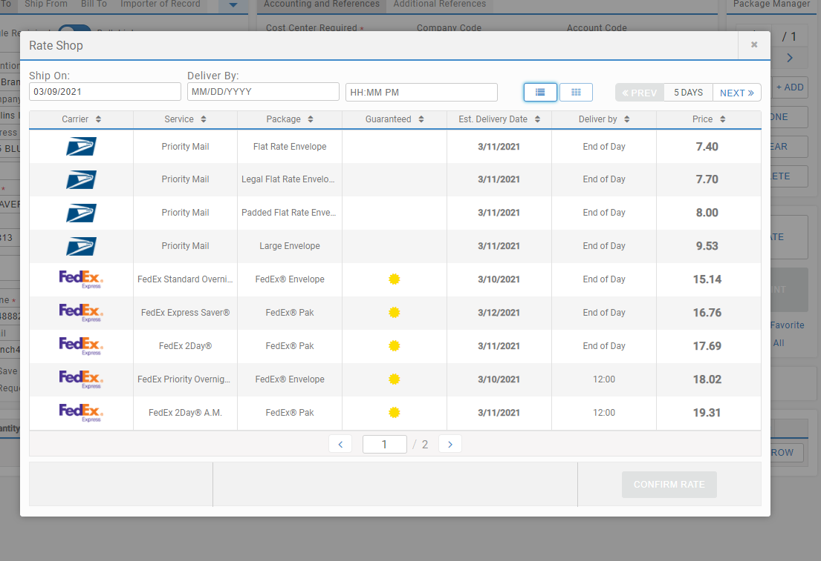
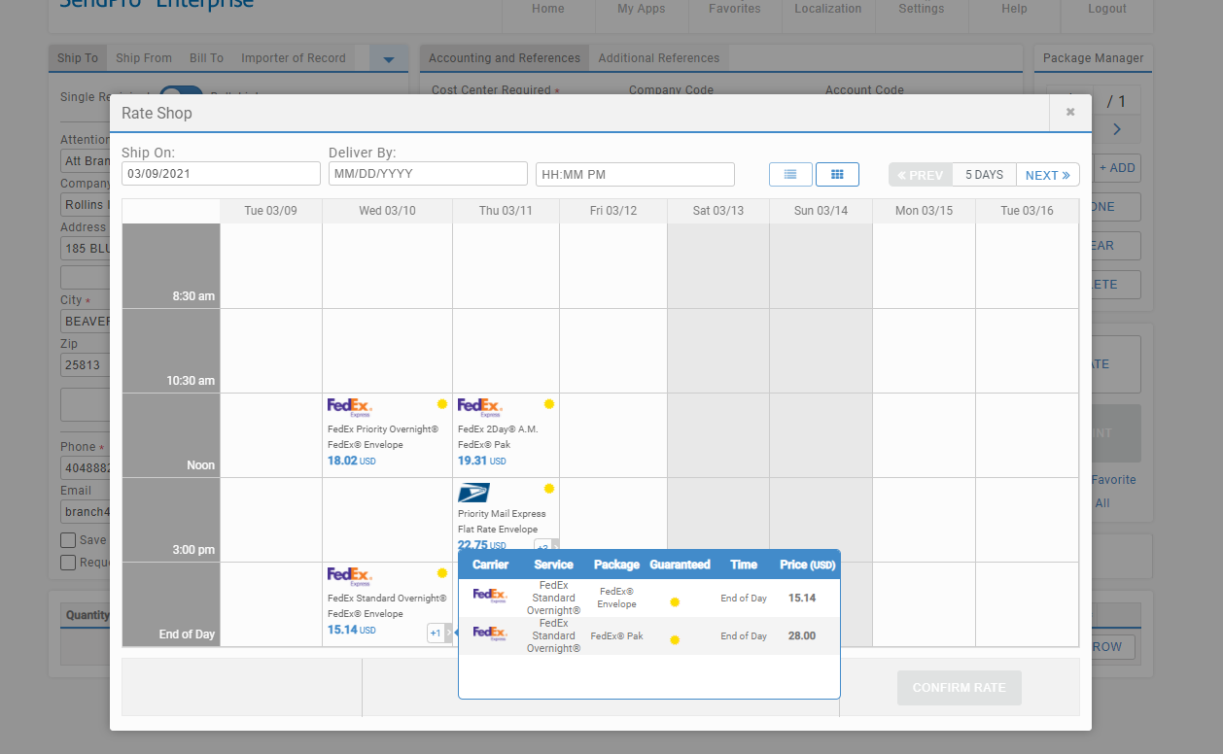
How to Ship a Package
There 2 views to see rates depending on the one you select.
The + sign in the calendar view means there are more than 1 service for the same carrier for the same day.

Slide 8
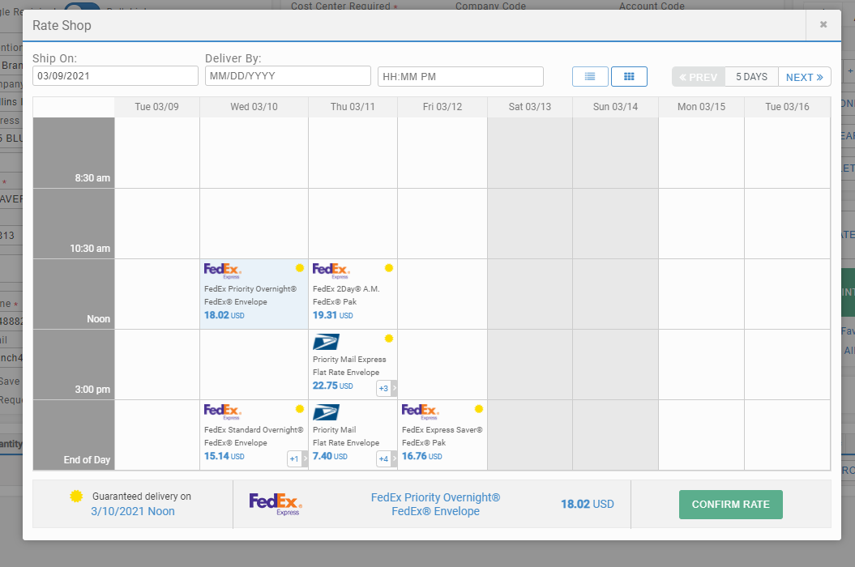
How to Ship a Package
Click
Rate selected

Slide 9
Click to Print Label

Slide 10
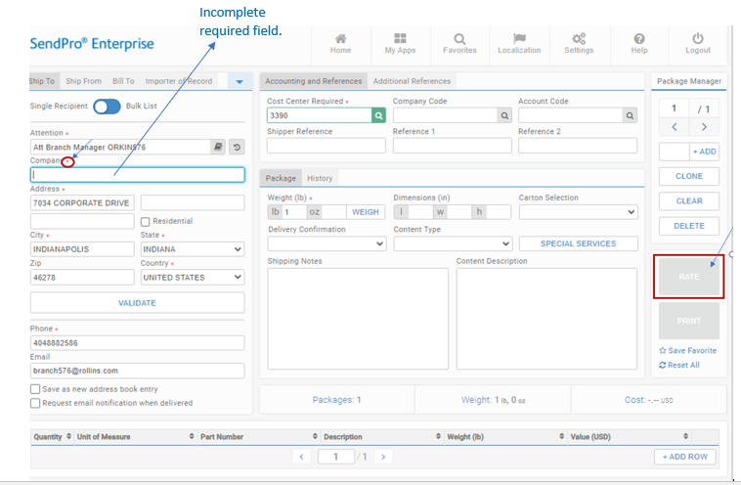
How to Ship a Package
If the “RATE” button is greyed out when you are shipping a package, please make sure all the red flagged required fields are completed. If not, it will not allow you to rate a package.

Slide 11
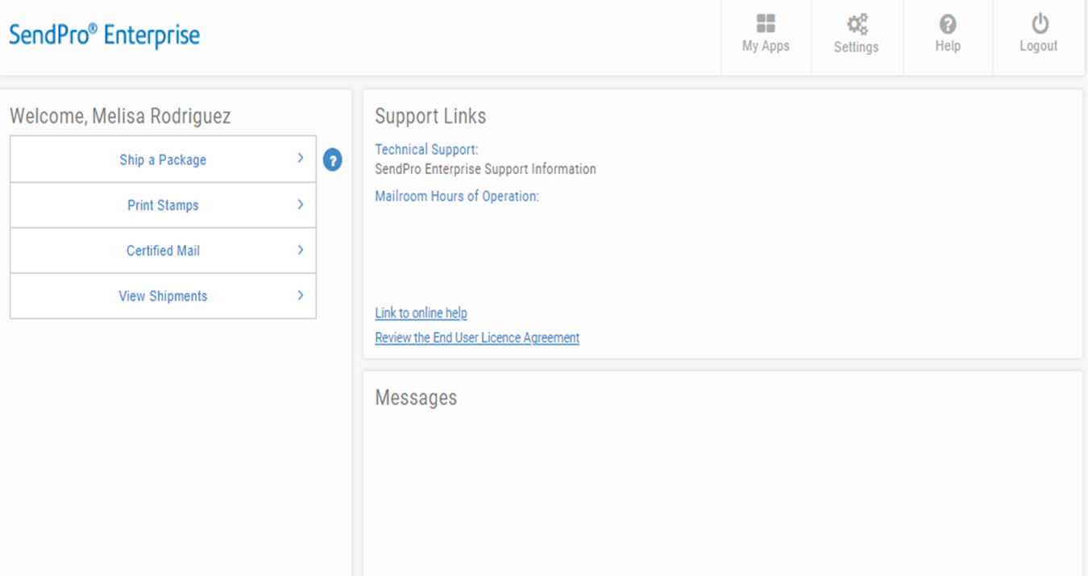
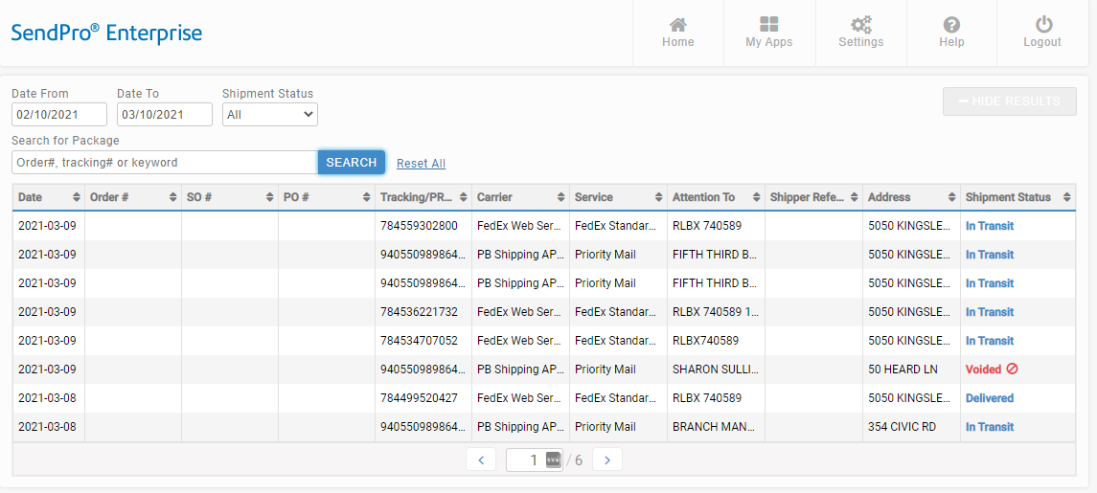
How to See Shipping History and Void a Shipment
Select shipment you want to void

Slide 12
How to See Shipping History, Track and Void a Shipment

Slide 13
How to Print Stamps

Slide 14
How to Print Stamps
Serial # from the stamp sheet located in the upper right corner.
Note: The next time the same serial # is used to print additional stamps the system will know to print on the 10th position.
Predetermined
Recommend to do a test print first on a white sheet of paper so that you align your printer correctly to the stamp sheet.
Provides the sum of the stamps to print.
Print stamp sheet

Slide 15
What to do if you get a blank screen when trying to print stamps?
Below is the directions in the setting that need to be changed:
Go into settings on Chrome.
Privacy- security- site settings- scroll down to additional content settings- option for PDF documents- select open PDF in chrome instead of downloading it.
Once you change the PDF selection, please close, and reopen browser and try again.

Slide 16
How to Send Certified Mail/Proof of Mailing

Slide 17
How to Send Certified Mail/Proof of Mailing
Enter Stamp Sheet Serial Number
Click “Extra Services” Dropdown
Check “Certified Mail” and “Return Receipt”
Print Stamps for Certified Mail
Click Rate
Notes:
- You still need complete the same forms as you do today.
- This function pays for the postage for the Certified Mail/Proof of Mail

Slide 18
How to re-print stamps
Open the Stamps app. If using the Desktop App, click Print Stamps from the landing page.

Slide 19
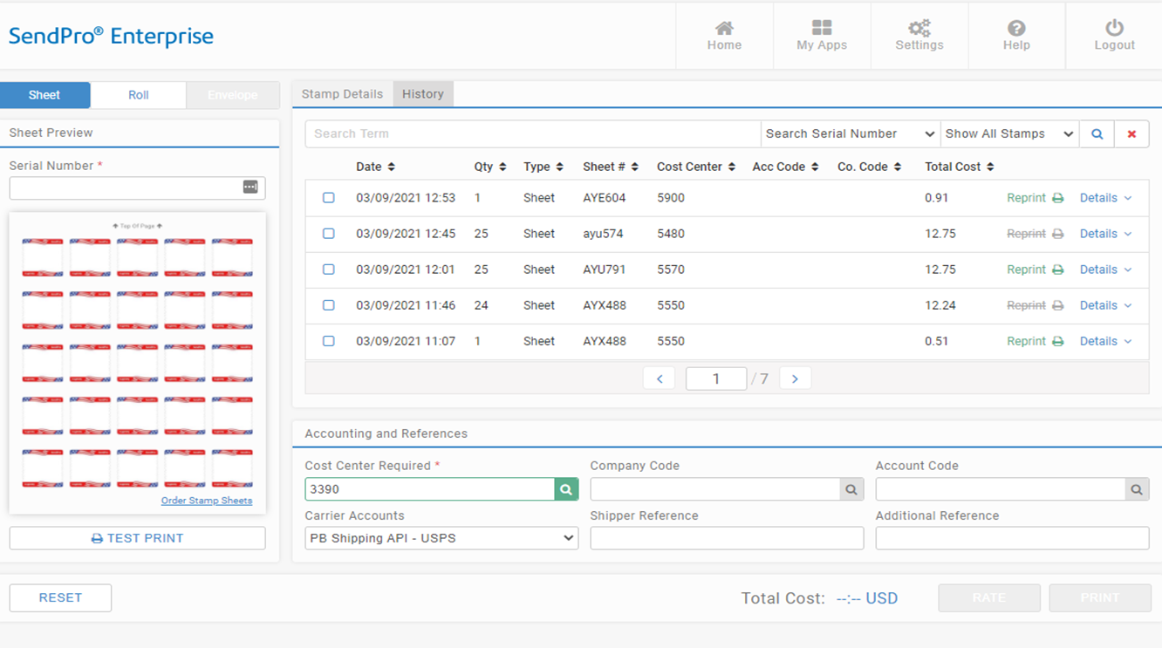
Enter the stamp sheet page serial number into the Serial Number field. If the serial number is correct, the stamp sheet image will display the used stamps with a USED watermark.
How to re-print stamps
NOTE: Only one reprint of a stamp sheet is permitted by USPS regulations and must be done within 24 hours of the original print. The original sheet must be destroyed.
Read and acknowledge the reprint disclaimer by clicking Confirm.
REPRINT SHEET.

Slide 20
How to view stamp print history
Open the Stamps app. If using the Desktop App, click Print Stamps from the landing page.

Slide 21
How to view stamp print history
Click on History and you will see the list of printed stamps.

Slide 22
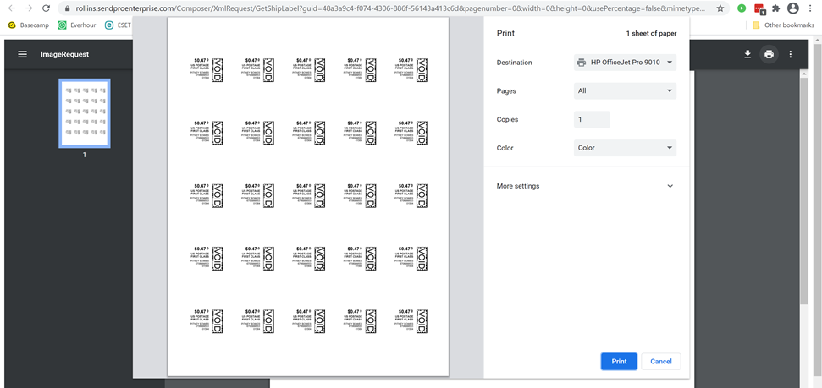
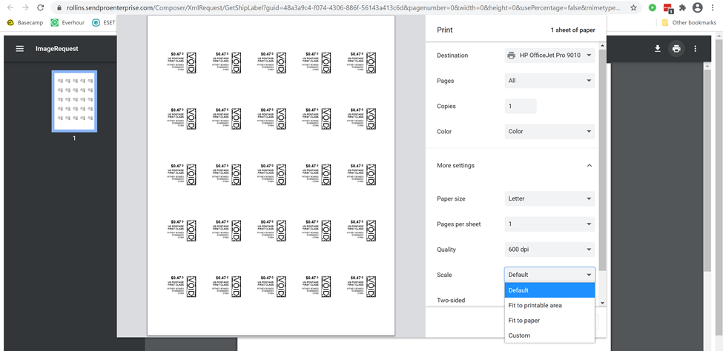
How to Align the Printer correctly to print stamps
Stamp Sheet Printer Alignment (Using Google Chrome – Recommended Browser)
When a user is doing a test print, in the printer dialog box, click the MORE SETTINGS down arrow. In the SCALE section in image 2, select “Default”. Put the test print page in and make sure the print lines up. Then hit PRINT.
If the user is having a difficult time controlling what print tray their printer feeds from, they need to do the following:
Right click on START and then go to SETTINGS>PRINTERS AND SCANNERS> Select your printer> MANAGE>PRINTER PROPERTIES>DEVICE SETTINGS>OUTPUT SETTINGS> Choose the tray you put paper in.

Slide 23
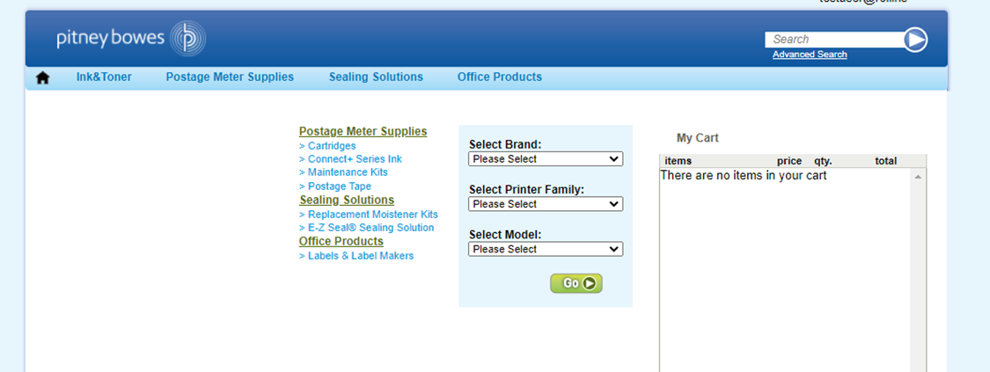
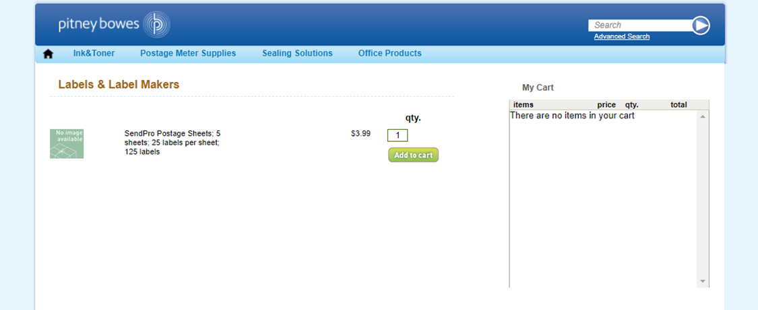
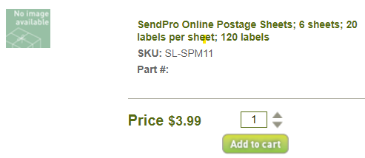
Rollins – Ordering Supplies
Ordering Supplies – This can be done through Ariba. These are the most common supply items:
Shipping Labels – These are from Office Depot - You can print 4X6 shipping labels for FedEx and Priority Mail on regular white paper and either slide it into a clear pouch or tape it to the item. If you want self-adhesive shipping labels these are your best bet.
- Avery® TrueBlock® White Laser Shipping Labels, Internet, 5126, 5 1/2" x 8 1/2", Pack Of 200
Scales – These are from Office Depot - These are being sent as a batch when new divisions are being set up but if you need an additional scale or are a new user, they can be ordered direct from Office Depot. These are the scales that we recommend:
- DYMO® M5 Digital Postal Scale Item # 780117 – 5 LB
DYMO® M25 Digital Postal Scale Item # 780153 – 25 LB
Boxes - order supplies for FedEx and USPS through PB.com - https://www.pitneybowes.us/shop/home/en-us/storeus
Stamp Sheets – ONLY ORDER STAMP SHEETS THROUGH PITNEY BOWES MARKETPLACE. Part number Item #SL-SPM11 and cost $4.99 for 120 Stamps (6 sheets of 20 stamps). We recommend ordering enough to last you at least 1 month. See the Ariba instructions below.
Rollins Marketplace > Catalog > Pitney Bowes > Buy from Supplier > Office Products > Select the Labels > Add to Cart and check out.

Slide 24
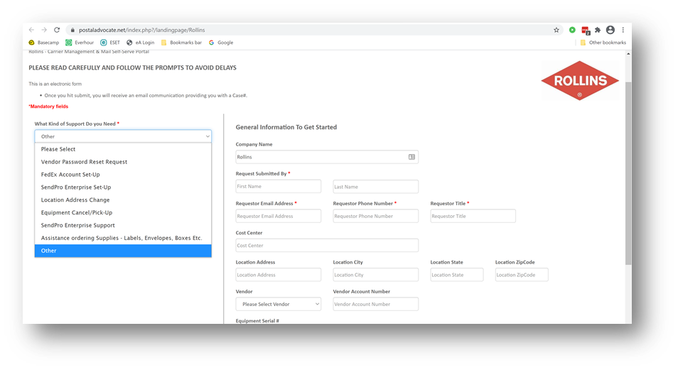
Internal Rollins Support
https://www.postaladvocate.net/index.php?/landingpage/Rollins
Select the kind of support you need, enter the information on the right and then hit next. A case will be created, you will get an email confirming the case number, and Postal Advocate will reach back within 24 hours to help resolve the issue.

Slide 25
Help
- Pitney Bowes/Send-Pro Enterprise Support, They have a very helpful series of screen shots and web tutorials. :
https://www.pitneybowes.com/us/support/products/sendpro-enterprise-support.html
- Pitney Bowes/Send Pro Enterprise Support Phone Number: 1-800-888-0286 Option 8

